Slide 1
Learning Curves
BUSI 104 – Operations Management
Professor Ed Arnheiter

Slide 2
Learning Curve Principles
1. Each time you perform a task it takes less time than previous time you performed same task
2. Extent of task time decrease decreases over time
3. Reduction in time will follow predictable pattern

Slide 3
General Comments on Learning Learning curves can be applied to individuals or organizations
Individual learning is improvement that results when people repeat process and gain skill or efficiency from their own experience; "practice makes perfect"
Organizational learning results from practice as well but also comes from changes in administration, equipment, and product design
In organizational settings, we expect both kinds of learning to occur simultaneously and often describe combined effect with single learning curve

Slide 4
Plotting Learning Curves Example for a 90% Learning Curve
Unit | Processing Time
1 | 100
2 | 90
4 | 81
8 | 73
16 | 66
32 | 59
64 | 53
128 | 48
256 | 43
Initial Processing Time = 100 hr/unit
For every doubling of production, processing time is only 90% of the previous value
Decrease in processing time/unit as production doubles will normally range from 10% to 20%

Slide 5
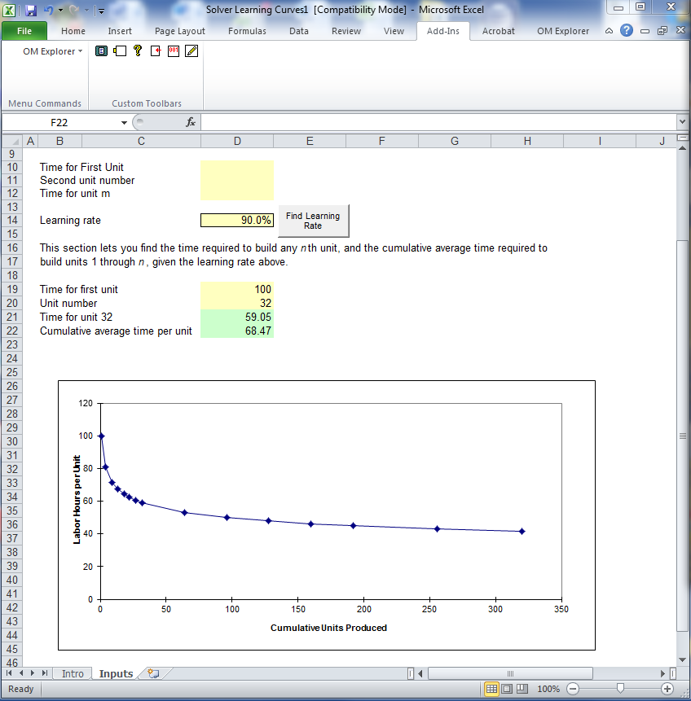
Learning Curve Plot using OM Explorer Add-in for Excel

Slide 6
Limitations of Learning Curve
Most useful for non-repetitive, complex jobs requiring long time to complete (e.g., airplanes, space vehicles)
Limited use for mass production and assembly-line type jobs
Learning for mass production jobs can flatten out quickly, and then show virtually no improvement:
End of improvement from learning
Processing Time per Unit
“Standard Time”
Units produced

Slide 7
Learning Curves How to find the time required to build the nth unit

Slide 8
Swimming Pool Example on HW
In OM Explorer: Solvers > Learning Curve Analysis > Learning Curves
Enter learning rate (e.g. 85%) in "Learning Rate" box
Enter "time for first unit" and "unit number" into cells D19 and D20.
Using 85% learning curve with time for first unit = 39, where we wish to know time required for 6th unit, software yielded "Time for unit 6" value of 25.64.

Slide 9
Swimming Pool Example on HW
MyOMLab may calculate slightly different value, but values between 25.60 and 25.64 should be within tolerance allowed for question.
Total time for all n pools - enter values 1 through n, one number at a time, in "Unit number" box and sum individual values to get total time.
For example, using sample data given above, this approach would yield following times and total:
39 + 33.16 + 30.16 + 28.20 +26.76 + 25.64 = 182.92

Slide 10
More on Pool Example
Previous learning curve assumes 15% reduction in time to build pool for every DOUBLING of production. 2nd pool time would be 0.85x39 = 33.15 hours, 4th pool would take .85x33.15 = 28.1775, 8th pool would take .85x28.1775=23.95, etc.
In case of 7th pool say, which lies between 4 and 8 pools, we can’t just use this simple math to find time required to build, or for that matter time required to build 9th pool, or 12th pool, etc. This is where OM Explorer software comes in handy.

Slide 11
Example Using Manual Method
Time required to build the nth unit =
[Time to build 1st unit][n^{{Log(Learning Rate)/(Log 2)}} ]
Note: You will need to round the exponent value to 3 decimal places in order to get the exact same answer as OM Explorer (i.e., round {Log(Learning rate)/Log 2} to 3 decimal places)
Example:
If we have a learning rate of 90%, and the time required to build the 1st unit is 50 hours, how much time will it take to build the 9th unit?
(50)(9^{{Log(.90)/(Log 2)}}) = 50(9^{{-.04576/.30103}} ) = 50(9^{-0.152}) = 50(0.716) = 35.80

